Slide 1


Slide 2
Part Three: Understanding Principles of Marketing
Understanding Market Processes And Consumer Behavior
Developing And Pricing Products
Distributing Products
Promoting Products

Slide 3
Chapter
10
Understanding Marketing Processes and Consumer Behavior

Slide 4
Chapter Outline
What Is Marketing?
Target Marketing/Segmentation
Marketing Research
Understanding Consumer Behavior
Organizational Marketing & Buying Behavior
International Marketing Mix
Small Business & The Marketing Mix

Slide 5
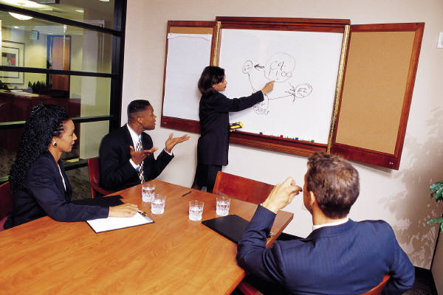
Marketing Mix
Of Goods & Services
Developing
Pricing
Placing
Promoting

Slide 6
Value & Satisfaction
Benefits- Functions Of Product & Emotional Satisfaction
Benefits Must Exceed Costs To Be Of Value To The Consumer
Value = Benefits
Costs

Slide 7
Utility = Satisfy Need/Want
Time
Place
Ownership/Possession
Form

Slide 8
Goods, Services, Ideas
Consumer Goods
Industrial Goods
Services- Intangible
Tangible

Slide 9
Relationship Marketing
Emphasizes Economic/Social Ties Between Buyer & Seller
Networking

Slide 10
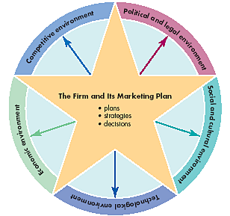
Marketing Environment

Slide 11
Marketing Environment
Political/Legal- Foreign & Domestic
Social/Culture- Changing Values In Today’s Dynamic Market
Technological- Obsolescence
Economic- Patterns/Levels Of Spending

Slide 12
Crude Oil Prices-
Yearly Average
Saudi Arabia Increases Production
US Emphasis On Energy Efficiency
Gulf War
OPEC Formed
Yom Kippur War
Import Cutbacks
Iraq/Iran War
Source: “History if Illinois Basin Posted Crude Oil Prices”, http://www.ioga.com/Special/crudeoil_Hist.htm

Slide 13
Competitive Environment
Substitute Products
Brand Competition
International Competition

Slide 14



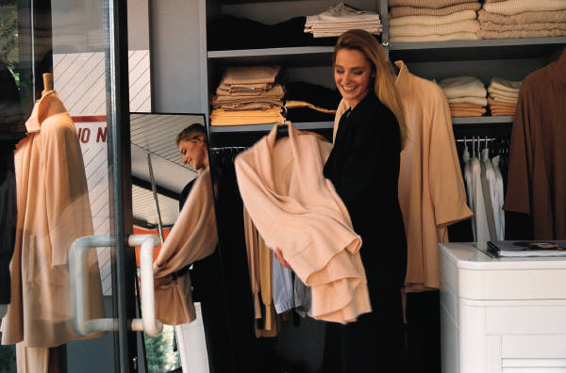

Marketing Mix (4 P’s)
Product
Price
Place
Promotion

Slide 15
Product
Good, Service, Idea To Fill Need Or Want
Product Differentiation

Slide 16
VHS Vs. DVD Rental
Source: Video Software Dealers Association

Slide 17
Price
Price Must Create Profit By:
  Covering Costs
  Attract Customers
High-Low Strategy
  Low = Large Sales Volume
  High = Greater Profit Per Unit Sold

Slide 18

Place
Getting Product From Producer To Consumer
Decisions Include:
  Storage
  Mode Of Transportation

Slide 19
Channels Of Distribution
Producer
Producer
Producer
Wholesaler
Retailer
Retailer
Consumer
Consumer
Consumer

Slide 20

Promotion
Communicate Information
Tools:
  Advertising
  Personal Selling
  Sales Promotion
  Public Relations

Slide 21
Web Effect On
Media Shopping
What’s the biggest way the Web has changed how you shop for media?
Source: “Add To Cart” Wired, 10/04, p. 70.

Slide 22

Target Market
Target Market- Group With Similar Needs/Wants
Product Positioning- According To Consumers’ Perception

Slide 23
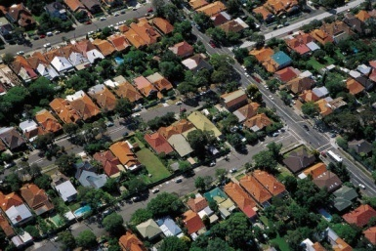


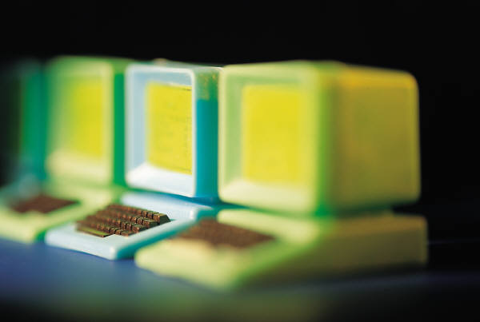
Market
Segmentation Variables
Geographic
Demographic
Psychographic
Behavioral

Slide 24
Geographic Variables
Places Consumers Reside
Countries > Neighborhoods
Water = Boats
Mountains/Rural = Four-Wheel Drive Vehicles
Urban Area = Designer Clothing

Slide 25
Demographic Variables
Age
Income
Gender
Ethnic Background
Marital Status
Race
Religion
Social Class
Others?

Slide 26

Psychographic Variables
Lifestyle
Interests
Attitudes
Can Be Changed By Marketing Efforts

Slide 27
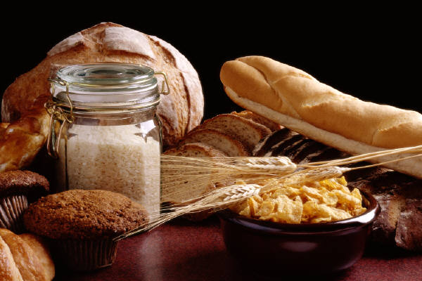
Behavioral Variables
Ways In Which Product/Service Is Used
Benefits Expected
Reasons For Purchase
Brand Loyalty vs. Switcher

Slide 28

Marketing Research
Study Consumer Needs/Wants
Determine Ways Sellers Can Satisfy Needs/Wants

Slide 29
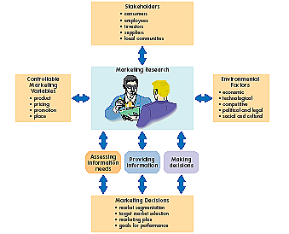
Marketing Research
& Process

Slide 30
Research Process
Study Situation
Select Method
Collect Data
Analyze Data
Prepare Report

Slide 31
Research Methods
Observation
Surveys
Experimentation
Focus Group

Slide 32
Influences On
Consumer Behavior
Psychological
Personal
Social
Cultural

Slide 33
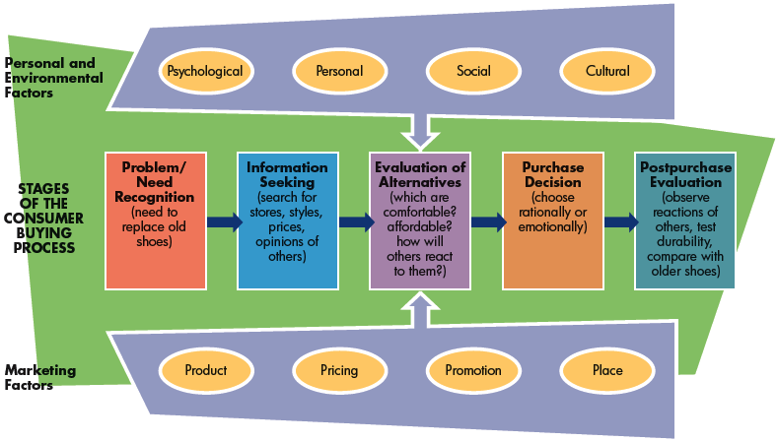
Buying Process

Slide 34

Data
Warehousing- Collecting, Storing, & Retrieving Data
Mining- Searching, Sifting, & Reorganizing Data

Slide 35
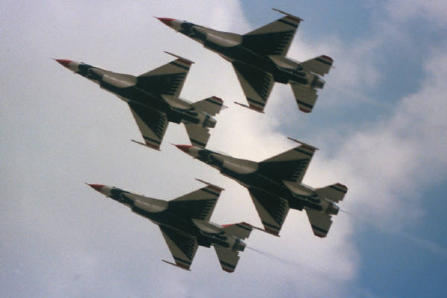
Organizational Markets
Industrial
Reseller
Government/Institutional

Slide 36

Buying Behavior- Organizational
Buyer Differences
  Professional
  Specialist
  Experts
Buyer-Seller Relationship

Slide 37
Marketing Mix- International
Products- Redesign For Foreign Buyer
Pricing- Cover Increased Cost Of Transport/Selling
Distribution- Delays In Establishing Network For Startup
Promotion- Cultural Differences

Slide 38
Marketing Mix-
Small Business
Products- Limited Buying Market
Pricing- Incorrect Cost Estimation
Distribution- Location Is Critical
Promotion- Local Which Is Cheaper

